Slide 1
PowerEnJoy
Project Presentation
Arcari Leonardo
Bertoglio Riccardo
Galimberti Andrea

Slide 2
Requirements Analysis
and Specification

Slide 3
Goals
[G.1] The customer shall be registered to rent a car
[G.2] The customer shall be able to find cars nearby
[G.3] The customer shall be able to reserve a car when he needs it
[G.4] The customer shall be encouraged to pick up the car he reserved in an hour
[G.5] The customer shall be encouraged to recharge the car after the rental end
[G.6] The customer shall be encouraged to share a ride with other people
[G.7] The customer shall be able to do a temporary stop
[G.8] A car shall be parked in a safe area
[G.9] A car shall not be picked without a reservation
[G.10] A car with low or empty battery shall be recharged by a road operator
[G.11] A car involved in an accident shall be reached by a road operator
[G.12] A faulty car shall be repaired

Slide 4
Key Domain Assumptions
The company is not responsible for driving infractions committed by the customers, and eventual fines and charges are taken in charge by the external payment service.
All the payment transactions from the customer to the company are successful; if a customer's credit isn't enough to pay his fees or fines the external payment service will inform the company, and the user will get banned.
The customers can't drive out of the city limits and agree to this when they accept the terms of service; otherwise, they can be legally sued by the company.
The safe areas are hard-coded in the software, as they aren't expected to change often; a management console for updating safe areas may be eventually added in the future.

Slide 5
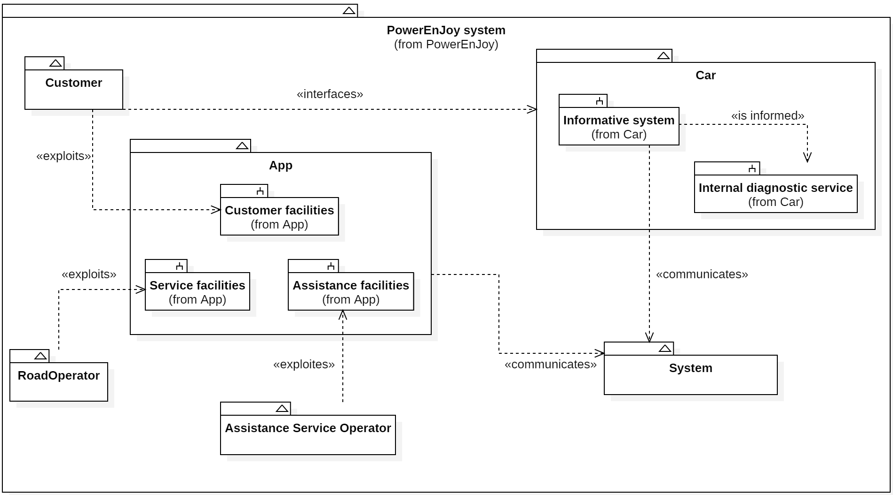
System Context

Slide 6
Internal System Interfaces
App ↔ System and Car ↔ System Communication
over the internet
through a set of APIs
cross-platform cross-language communication protocol
Human ↔ System Interaction
apps
presence sensors inside the car
touch screen inside the car

Slide 7
External System Interfaces
Payment Service
deal with billing operations
verify validity of the customer’s credit card
manage payment of rental fees and additional charges
Geolocation Service
provide map of the city with safe areas localization
locate cars in real time
calculate distances
Car Internal Diagnostics System
failures
battery level
doors and windows locking status
passengers presence

Slide 8
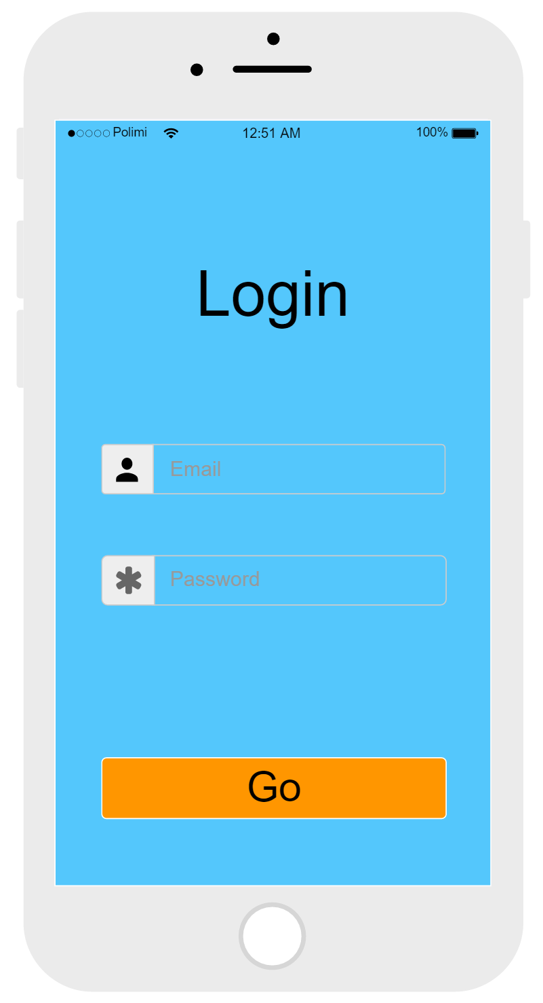
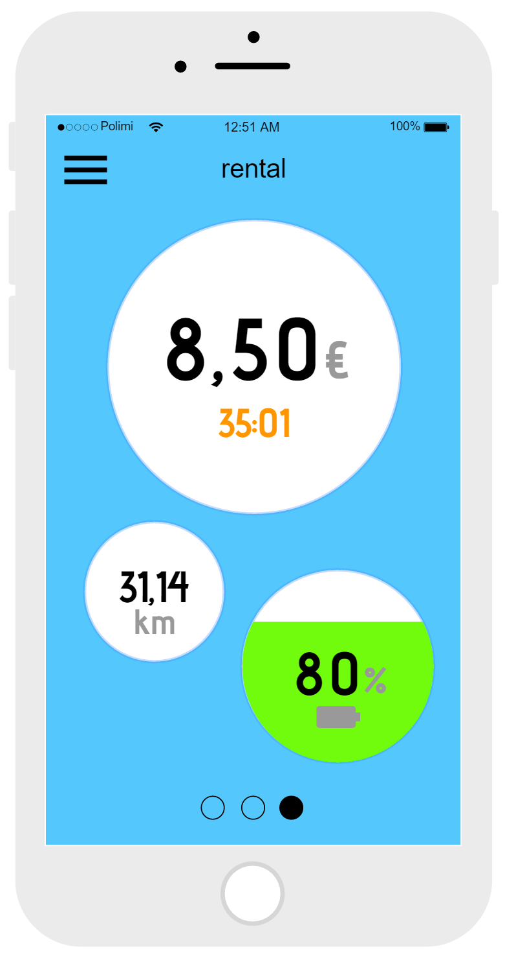
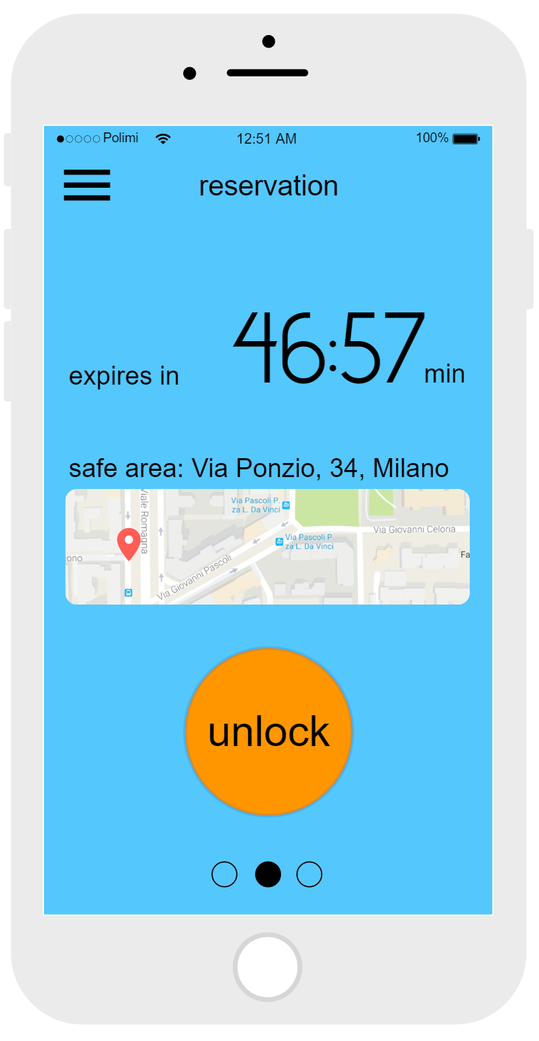
Mockups

Slide 9
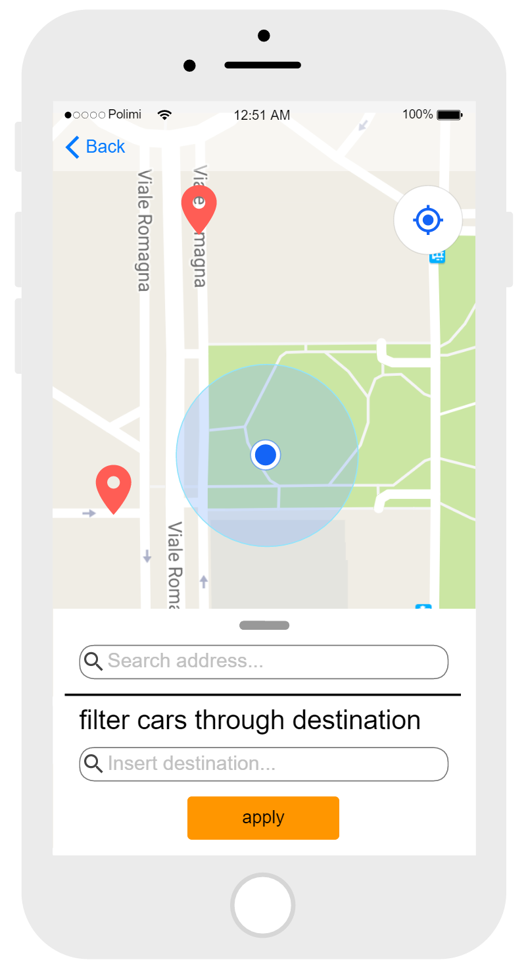
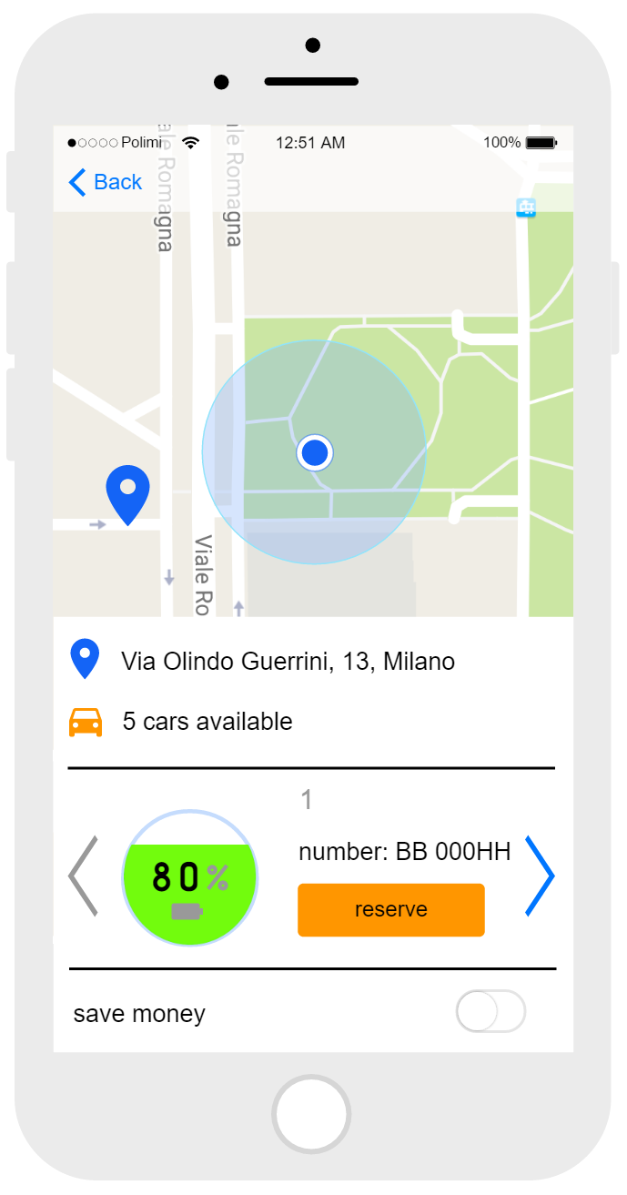
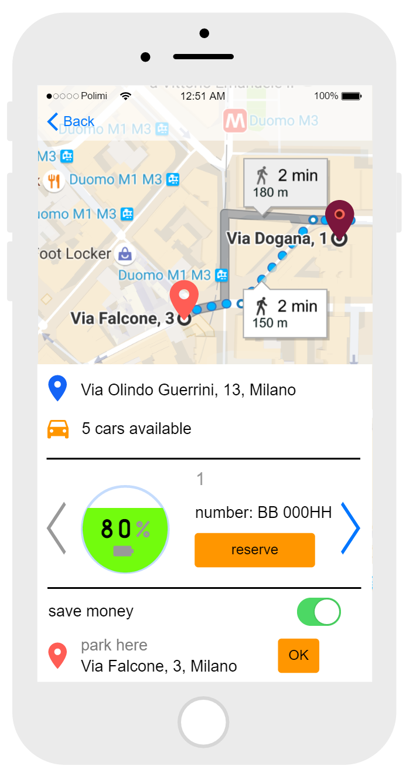
Mockups

Slide 10
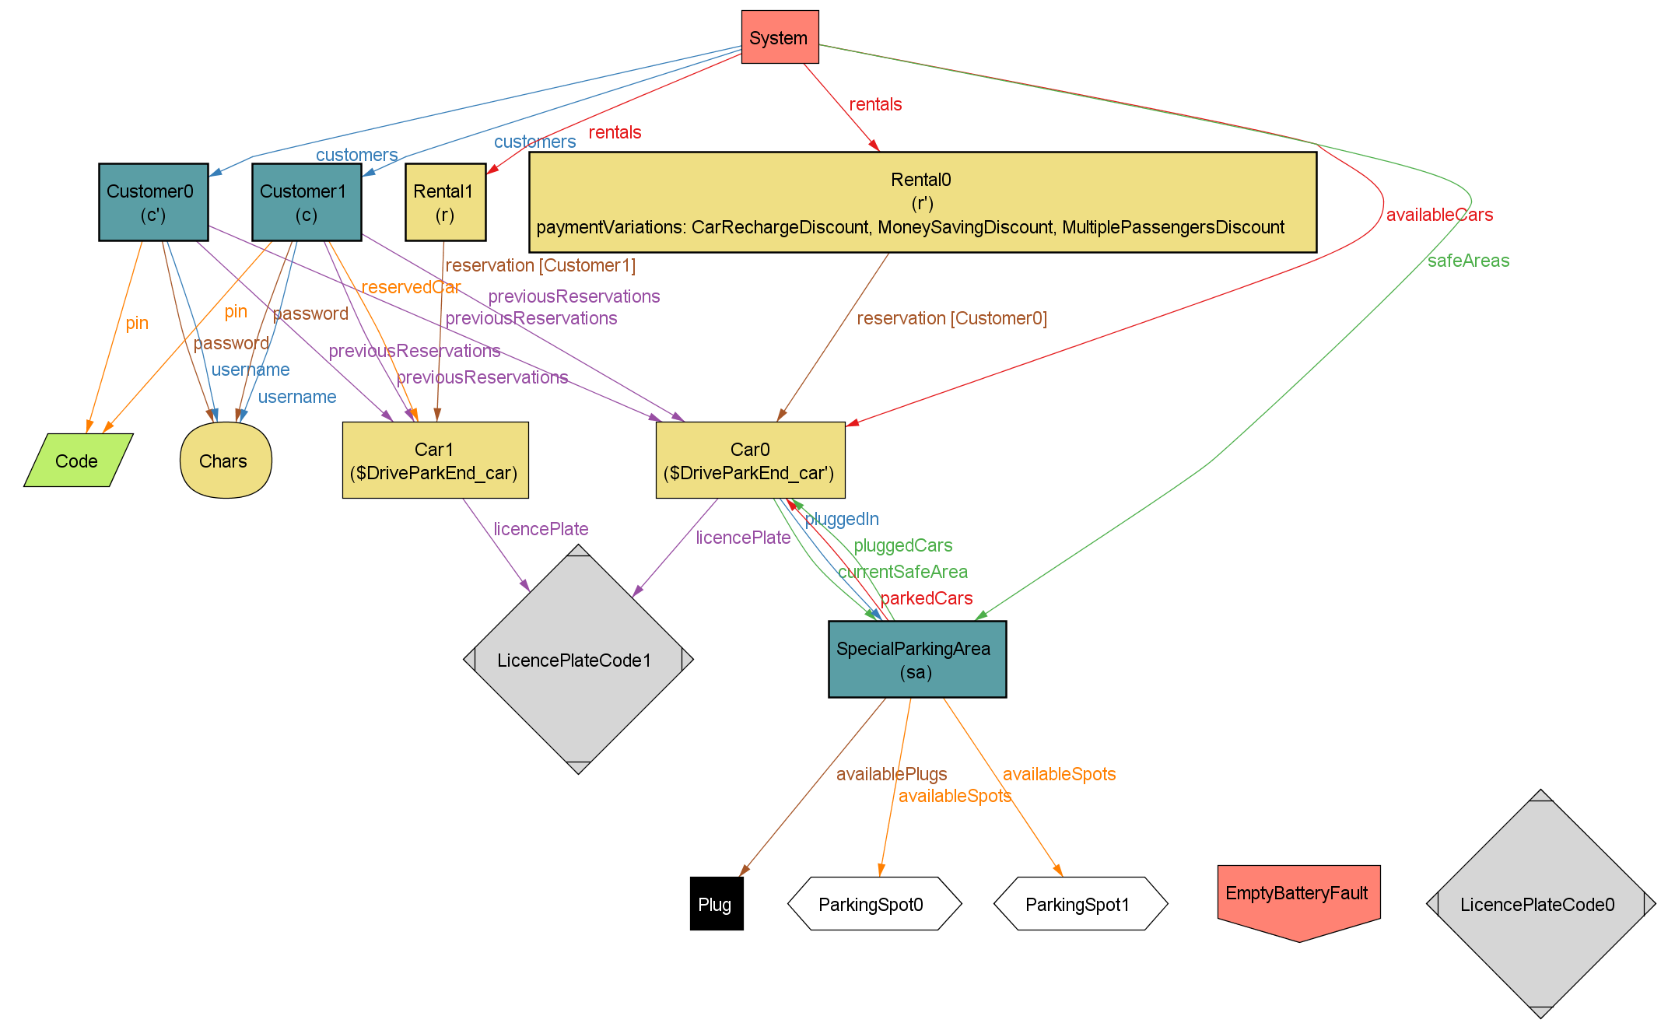
Alloy Model - Driving, Parking and Rental End

Slide 11
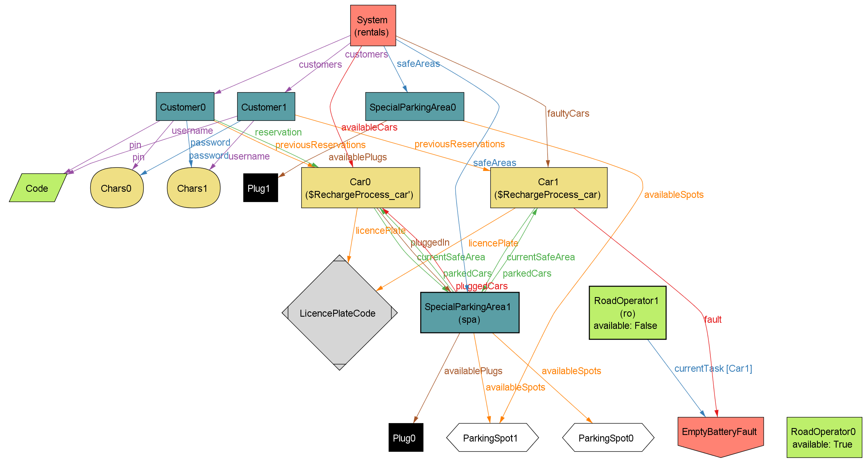
Alloy Model - Recharging Process

Slide 12
Architectural Design

Slide 13
Architectural Design
Car
Application
Customer
App
Road Operator
App
Assistance Operator App
Application Server APIs
Car
Logic
Customer
Logic
Road Operator
Logic
Assistance Operator Logic
Entities

Slide 14
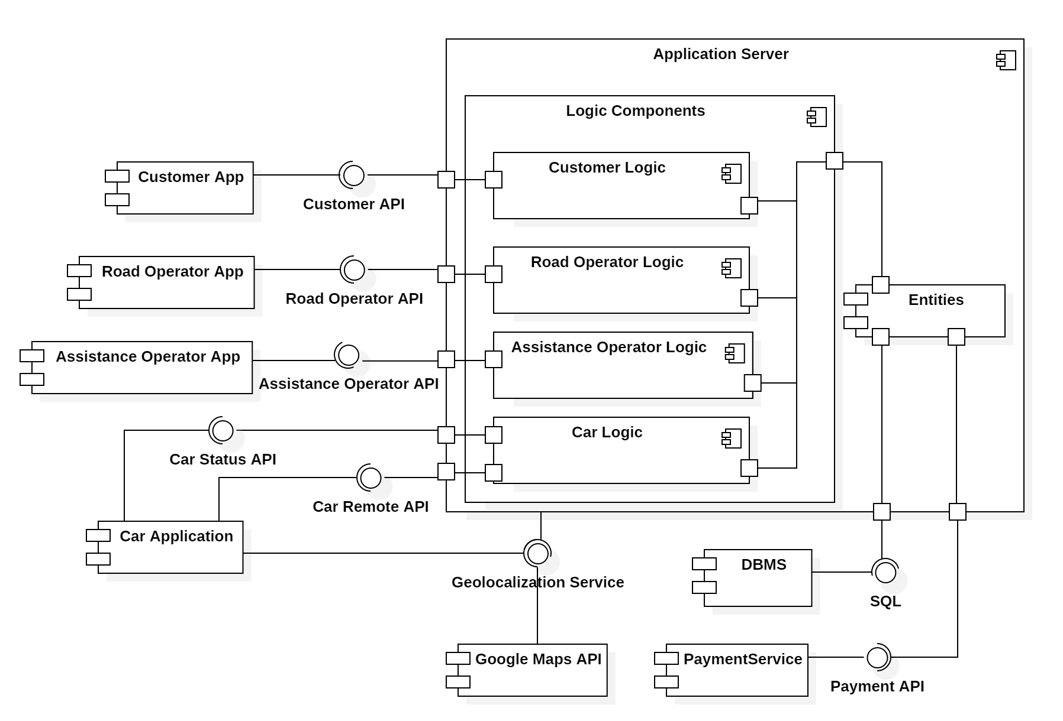
Architectural Design

Slide 15
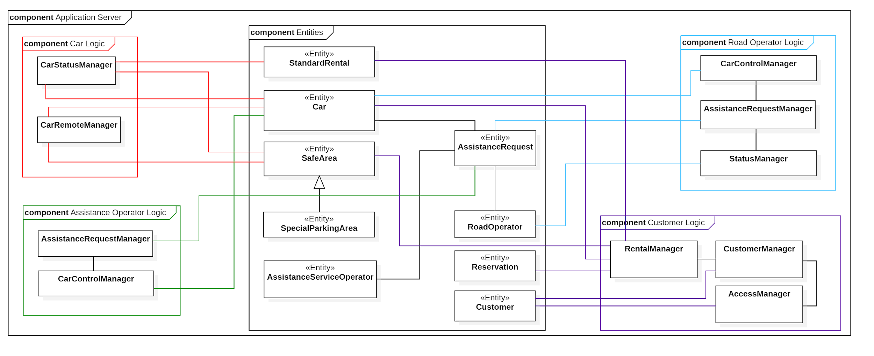
Application Server Component View

Slide 16
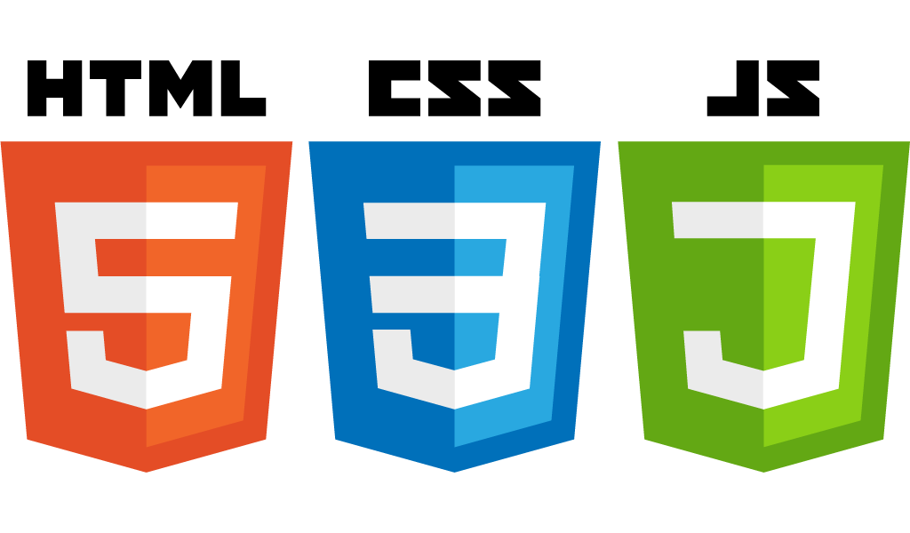





Adopted Technologies

Slide 17

Component interfaces
JSON Schema
Car Remote Control
Car Status Update (partial)
{ "$schema": "http://json-schema.org/draft-04/schema#", "title": "Car Remote Control", "description": "Remote Control operations", "type": "object", "properties": { "id": { "description": "ID of the car", "type": "string" }, "operation": { "type": "string", "enum": [ "unlock", "lock", "ok" ] } }, "required": ["id", "operation"], "additionalProperties": false }
{ "NumberOfPassengers": { "description": "Number of passengers", "properties": { "type": { "enum": [ "NumberOfPassengers" ] }, "passengers": { "type": "integer", "minimum": 0 } }, "required": [ "type", "passengers" ] } }

Slide 18
Integration Test and Project Planning

Slide 19
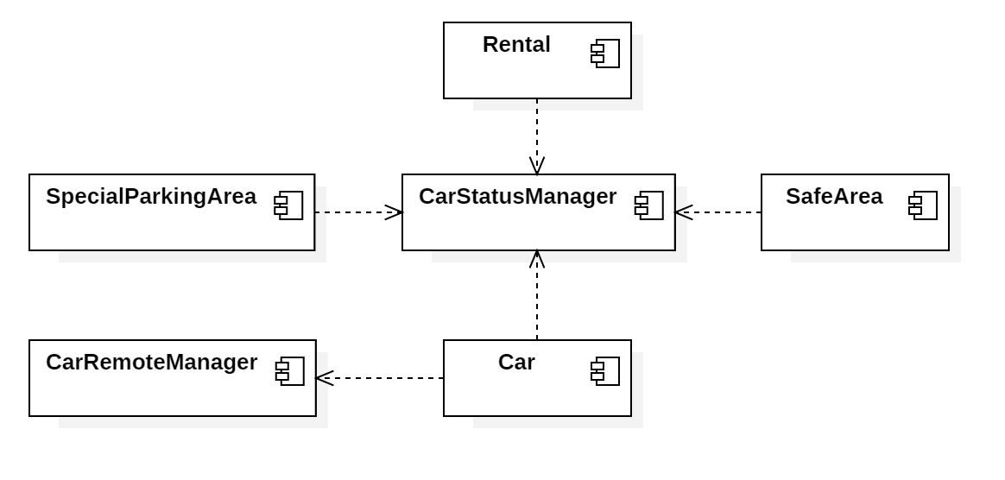
Integration Testing Strategy
Incremental integration test in a bottom-up fashion
Critical modules first (Car and Customer applications with the Application Server)
Steps:
Sub-components of logic components
Logic components
Apps and logic components
Third-party components

Slide 20
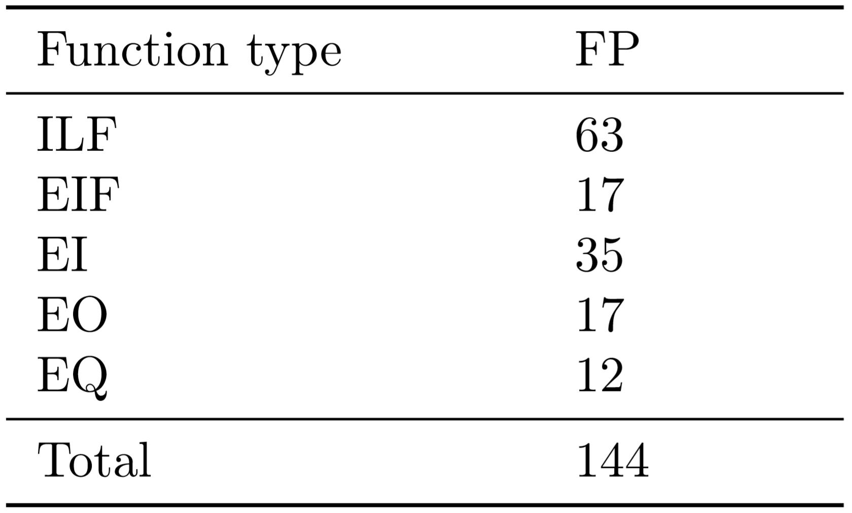

Project Planning
Size Estimation
Function points

Slide 21
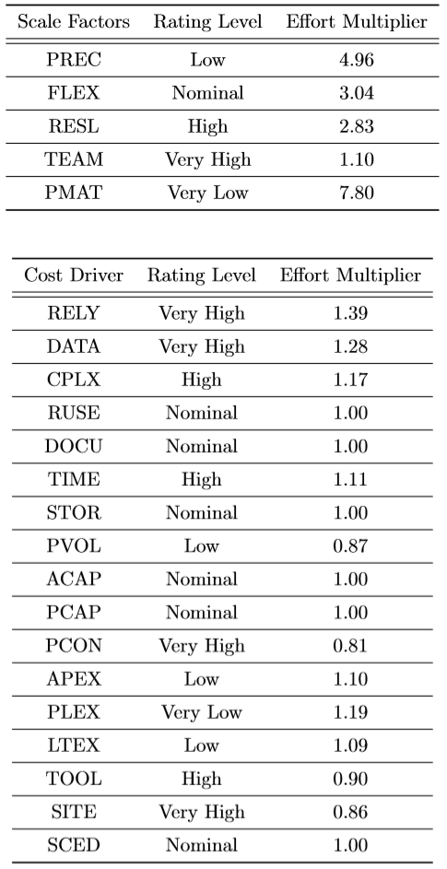
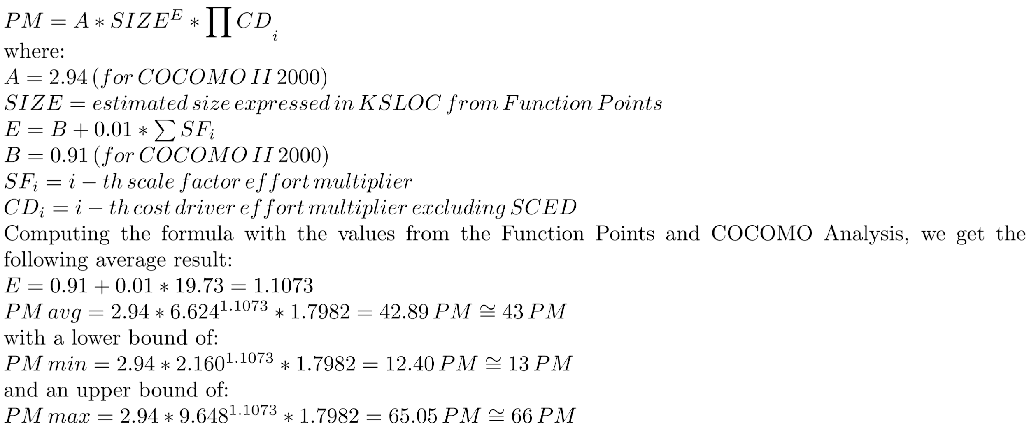
Project Planning
Eﬀort Estimation
COCOMO II

Slide 22
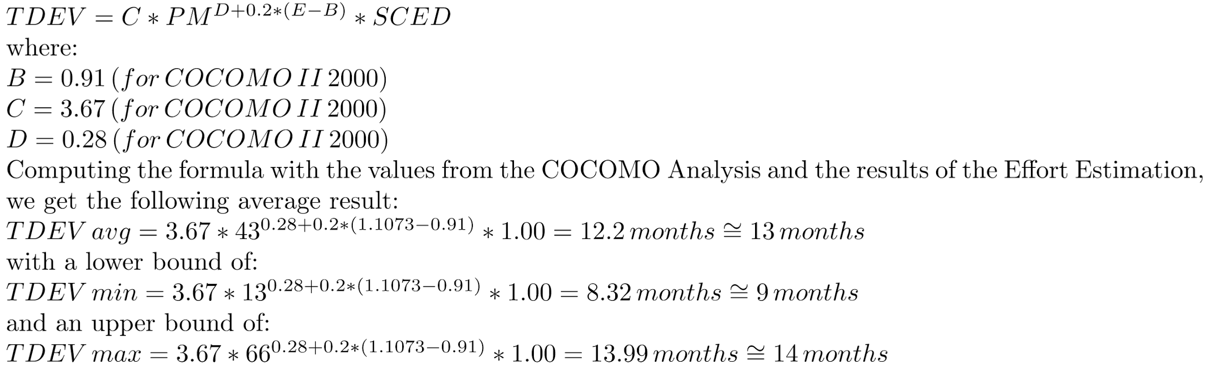
Project Planning
Schedule Estimation

Slide 23
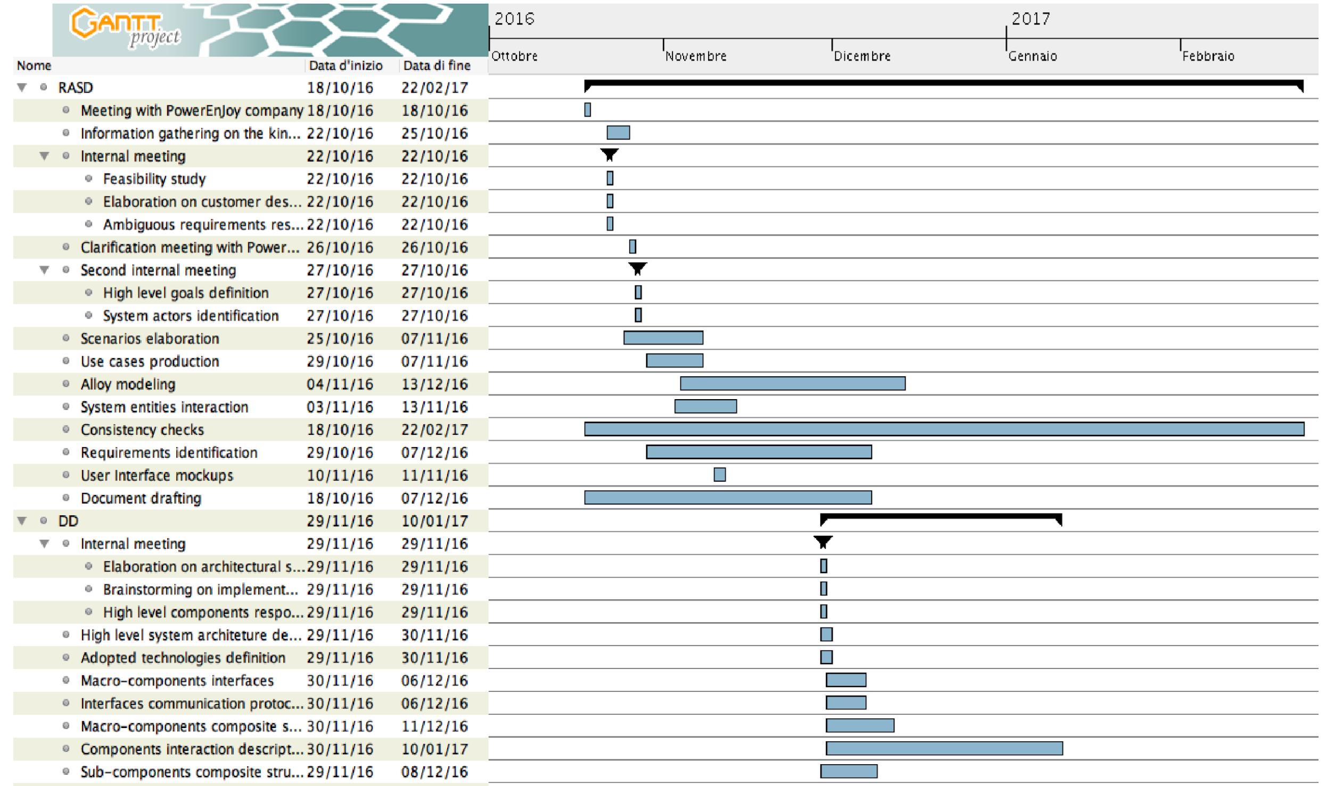
Project Planning
Schedule

Slide 24
Project Planning
Risk management
High impact risks:
It is impossible to recruit staﬀ with the skills required for the project
Technology/human faults causes project data loss
High probability risks:
Infrastructure owned by the company does not handle the throughput expected
The marketplace is saturated by products similar to PowerEnJoy and the customer will ask frequently for more features to be added in order to be competitive

Slide 25
Thank you for your attention

